Slide 1
The Wide Survey

Slide 2
Aims of wide survey and picking a telescope
Aims:
Lower redshift candidates
Lensing
Suitable areas for deep survey
Choosing a telescope for the wide survey
E ELT
Euclid
JWST
 | Time
Area | JWST | Euclid | E ELT
1 FoV | 0.79 hours | 6.1 hours | 1.33 hours
0.51 degrees | 12.23 days | 6.1 hours | 4.0 days
1 degrees | 24.46 days | 0.46days | 7.98 days
40 degrees | 978.44 days | 18.42 days | 319.40 days
 | JWST | Euclid | E ELT
FoV (degrees) | 0.00134 | 0.551 | 0.00694

Slide 3
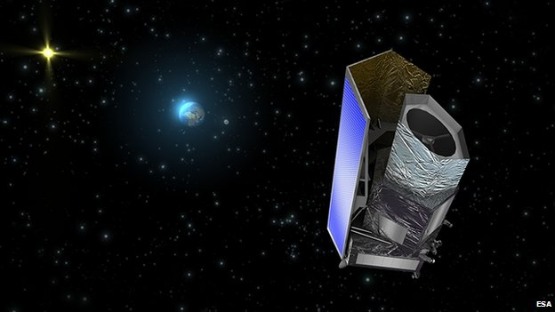
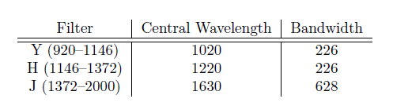
Euclid
Planned for launch 2018
Near IR, spectroscopy and visual photometry
Limitations
Small mirror diameter (1.2 m Korsh telescope)
Redshift range
Uses
Large field of view
Gravitational lensing
Lower redshift candidates

Slide 4
Euclid surveys and Exposure times
Wide survey
24th mag AB
Gravitational lensing
Narrow survey
26th mag AB
Higher redshift galaxies
Spot better lenses
How long will the surveys take?
Euclid documents estimate 6.5 years for survey completion
Wide survey- 1 pointing at each patch of sky
Narrow survey
4-6 months continuous
6 years spread over wide survey

Slide 5
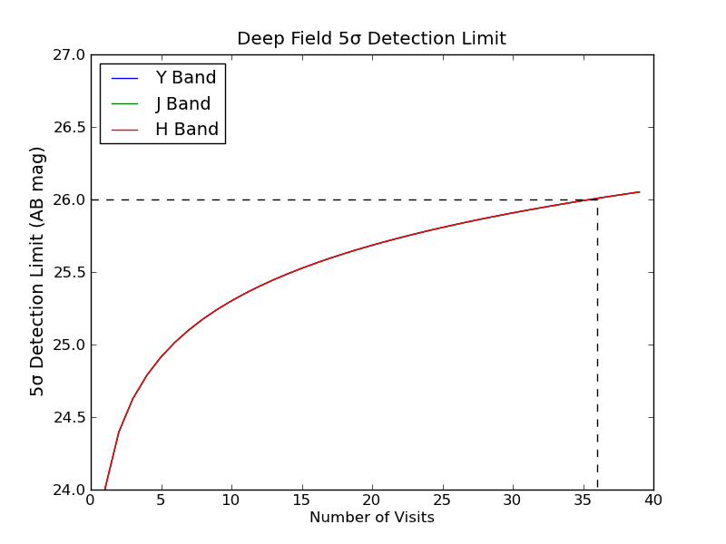
40 exposures

